Slide 1
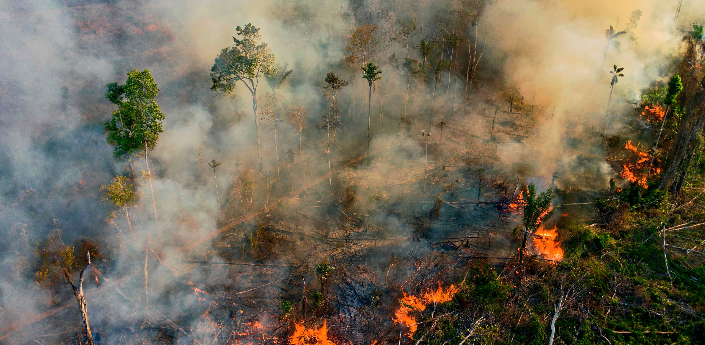
Bayesian spatio-temporal modeling of Brazilian firespots
Jan Fritz
Niklas Viebig
Luca Titze
Victor Windhab
Image Source

Slide 2
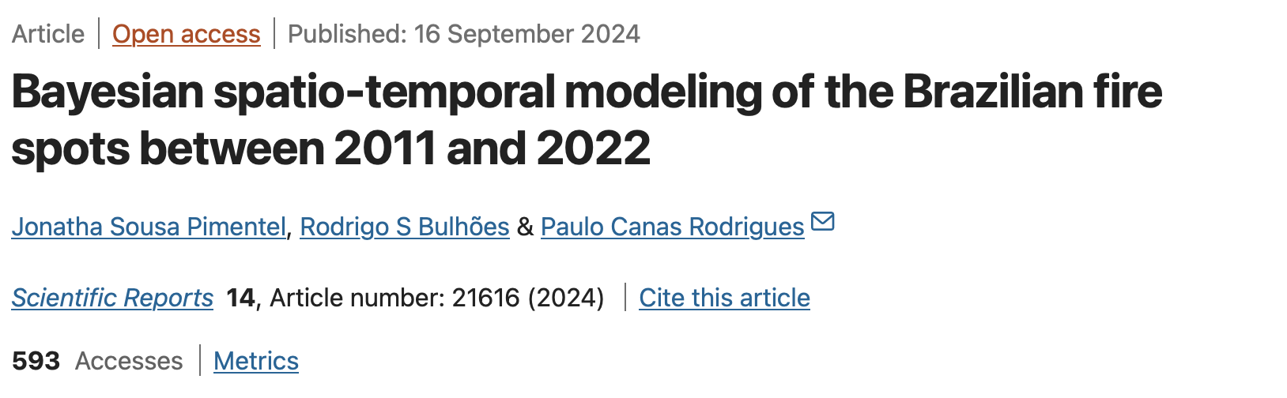
Note:
These slides are based on the paper by Jonatha Sousa Pimentel, Rodrigo S. Bulhões, and Paulo Canas Rodrigues. The authors are affiliated as follows:
1. Department of Statistics, Federal University of Pernambuco, Recife, Pernambuco, Brazil (Jonatha Sousa Pimentel).
2. Department of Statistical Methods, Federal University of Rio de Janeiro, Rio de Janeiro, Brazil (Rodrigo S. Bulhões).
3. Department of Statistics, Federal University of Bahia, Salvador, Bahia, Brazil.
4. Department of Statistics, Islamic University of Indonesia, Jogjakarta, Indonesia (Paulo Canas Rodrigues).
5. These authors contributed equally: Jonatha Sousa Pimentel, Rodrigo S. Bulhões, and Paulo Canas Rodrigues.
Corresponding author: paulocanas@gmail.com

Slide 3
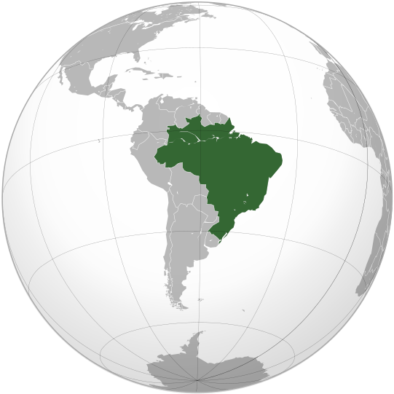
Agenda
Background
Data & Model
Understanding the data
Model
Bayesian approach
Sampling the posterior (MCMC)
Goodness of fit & Compare models

Slide 4
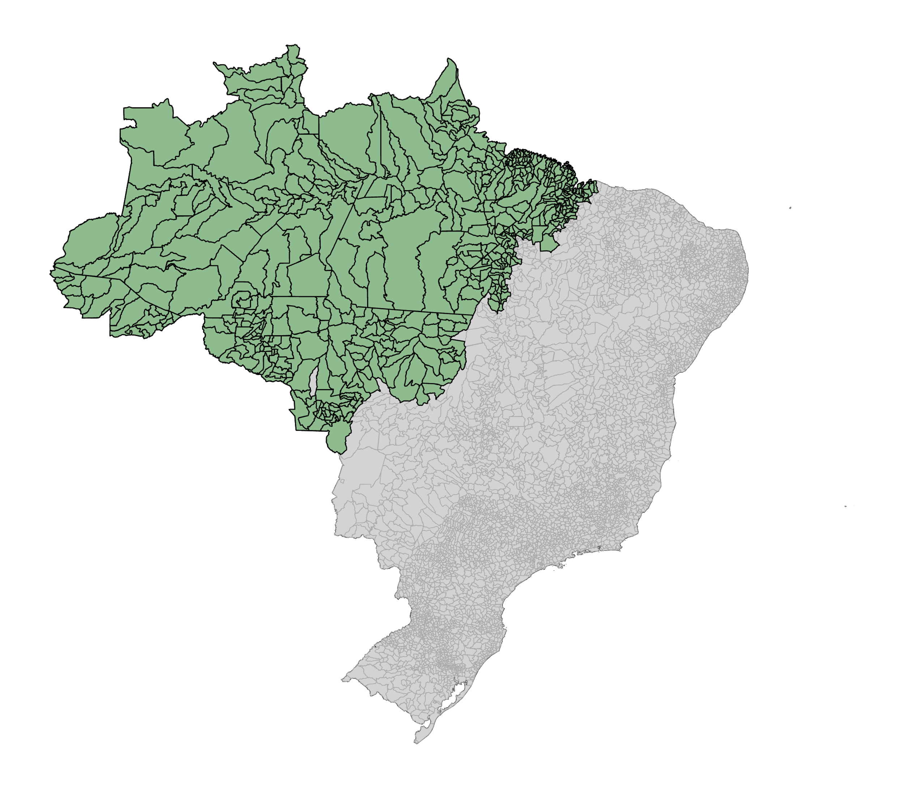
Background
Overview: Analysis of fire spots in Brazil over 10 years.
Significance: Wildfires are devestating natural disasters, intensified by climate change.
Particularly impactful in regions like Brazil, home to unique ecosystems.
Data: Historical records of 22 million fire spots detected across Brazil.
Focus on Amazonia the heart of the world’s largest rainforest.
Objective: Spatio-temporal modeling using Bayesian frameworks.
Incorporates meteorological factors (e.g., temperature, humidity) and human activities (land-use transitions).
Why Amazonia Matters:
60% of the world’s largest rainforest.
Home to vast biodiversity, mineral reserves, and 20% of global freshwater.

Slide 5
Understanding the data
Data Size: (66960, 9), 588 municipalities * 120 months of observation * 7 variables =
493.920
Data available on GitHub: Link

Slide 6
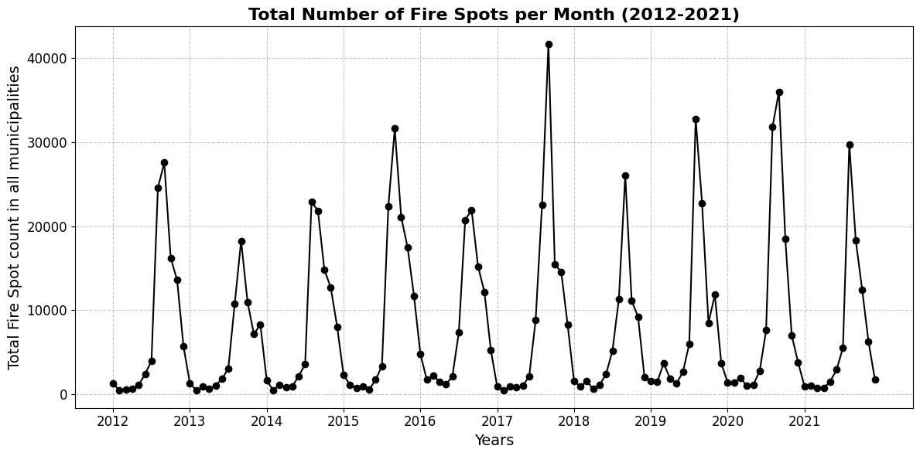
Understanding the data

Slide 7
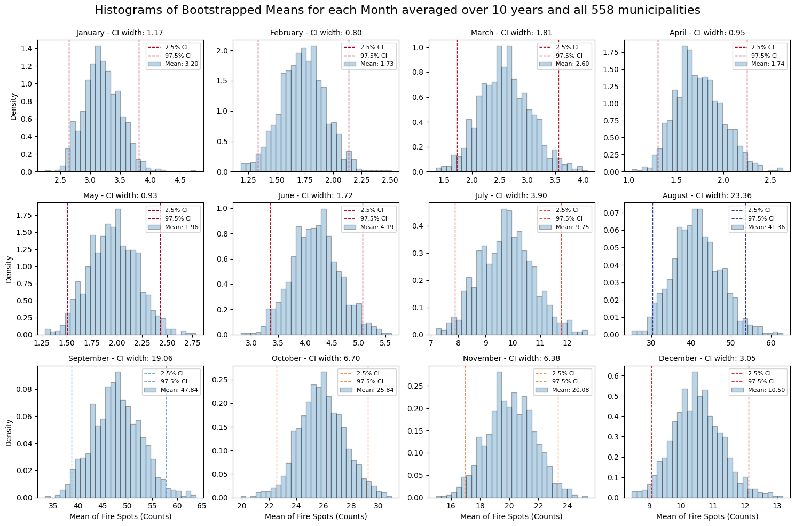
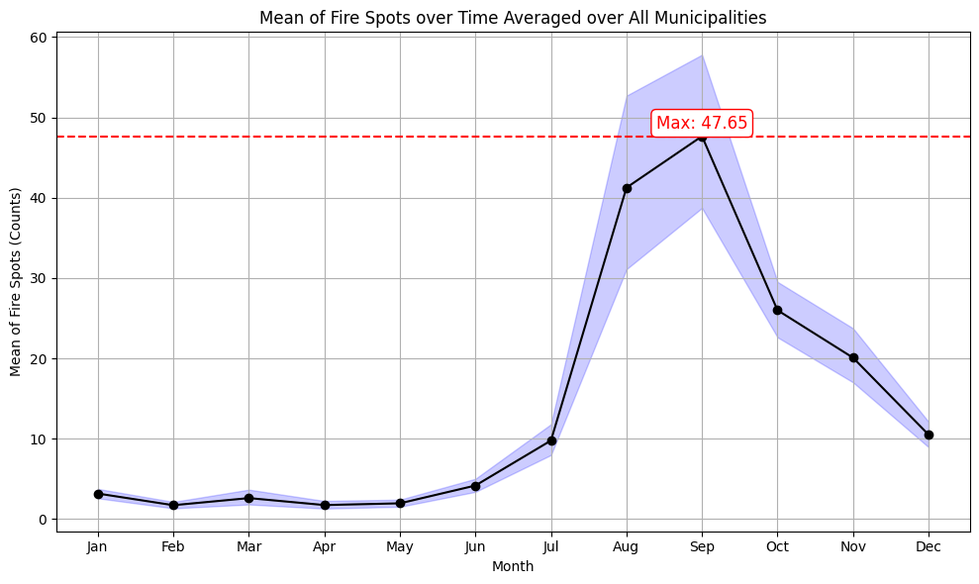
Understanding the data
In months with wide confidence intervals, a few municipalities with extreme values influence the mean:
• Most municipalities have much lower counts, creating high variability in the data.
• This results in greater uncertainty and wider CIs when estimating the average for those months.

Slide 8
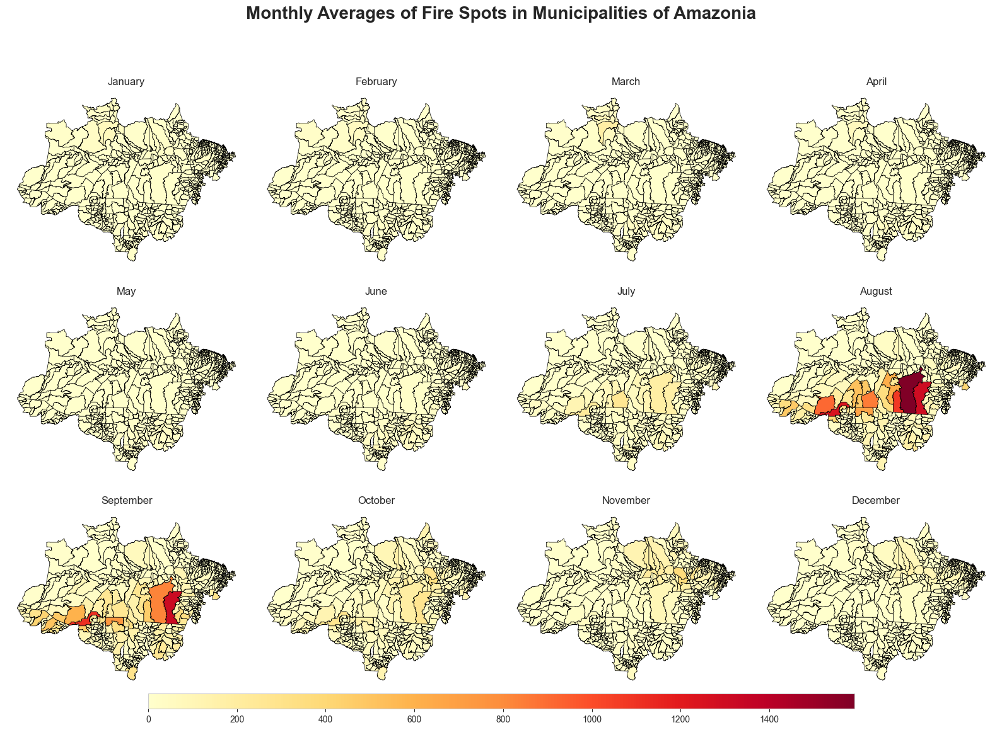
Understanding the data

Slide 9
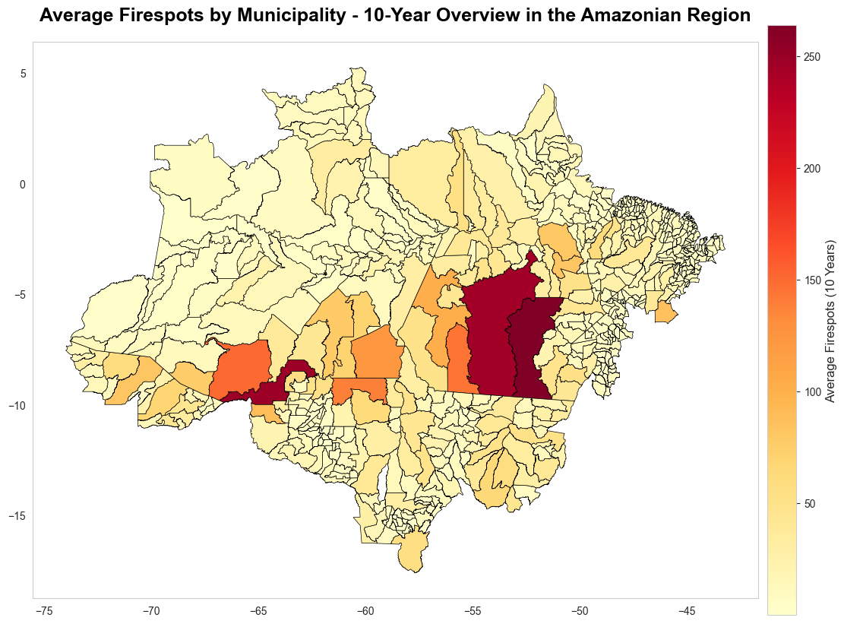
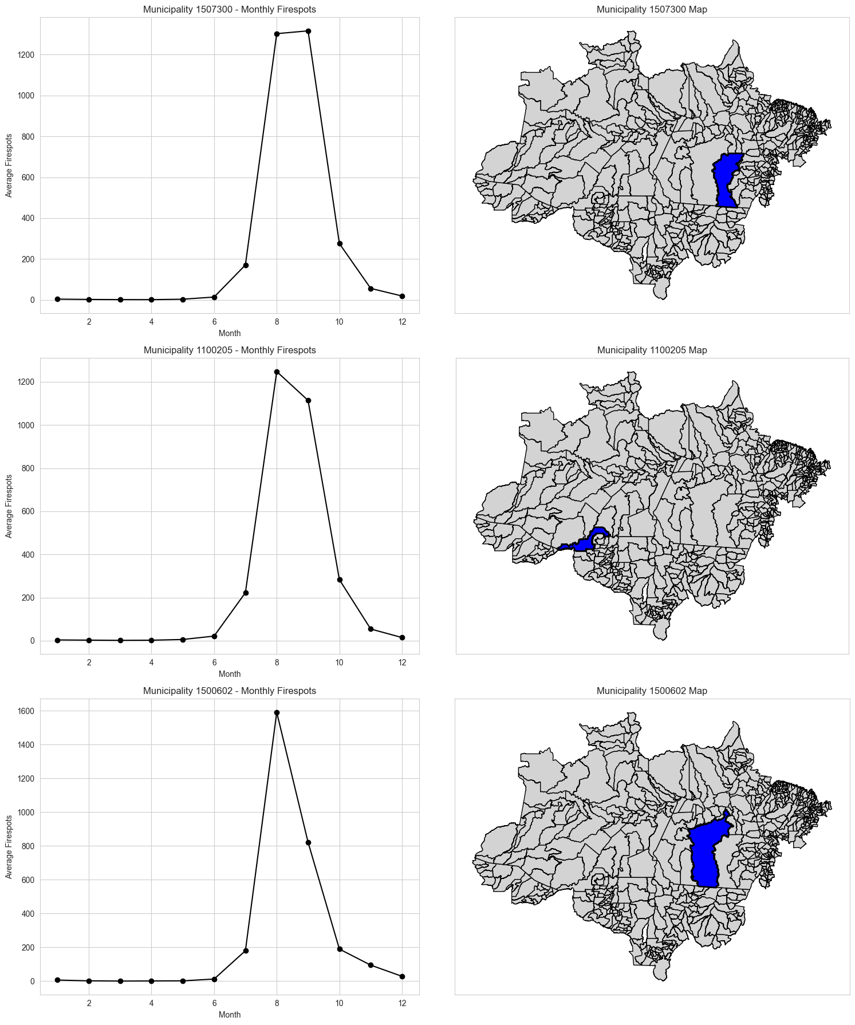
Understanding the data

Slide 10
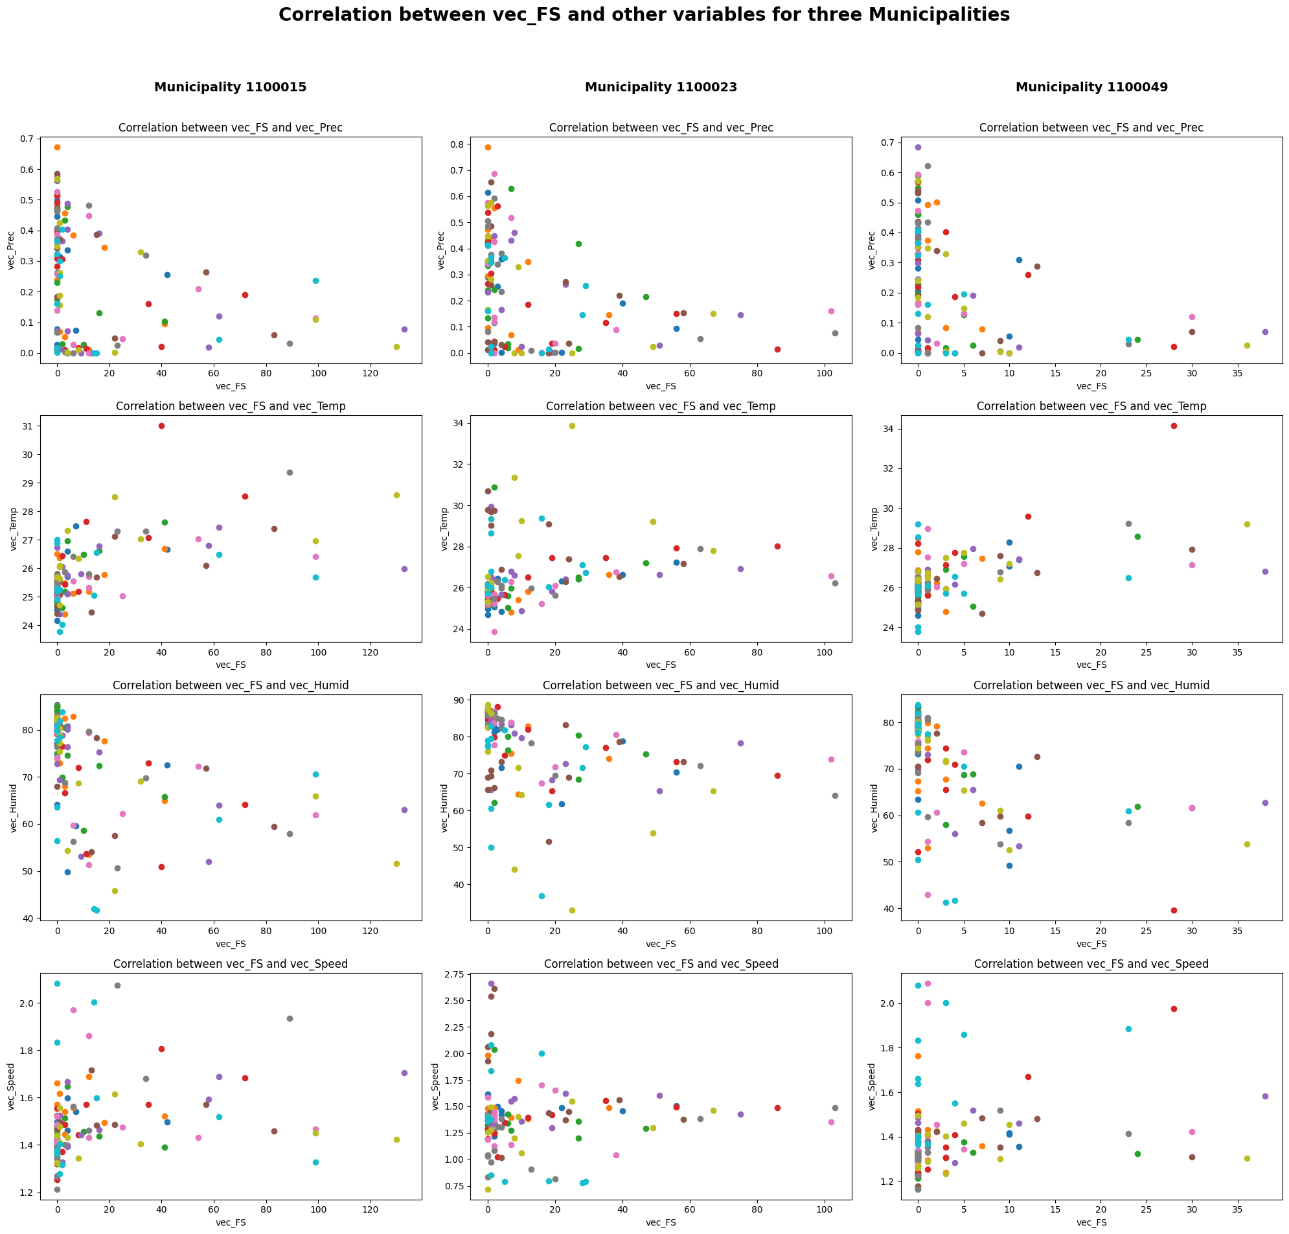
Understanding the data

Slide 11
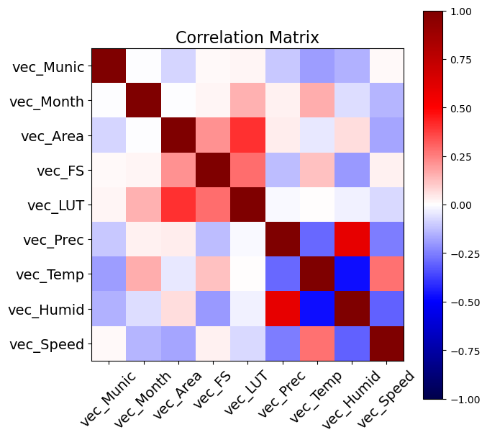
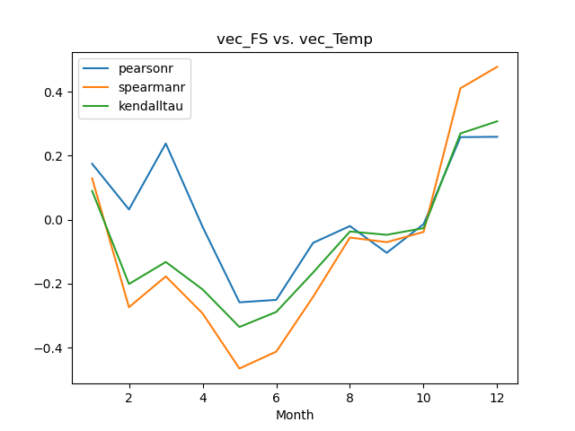
Understanding the data

Slide 12
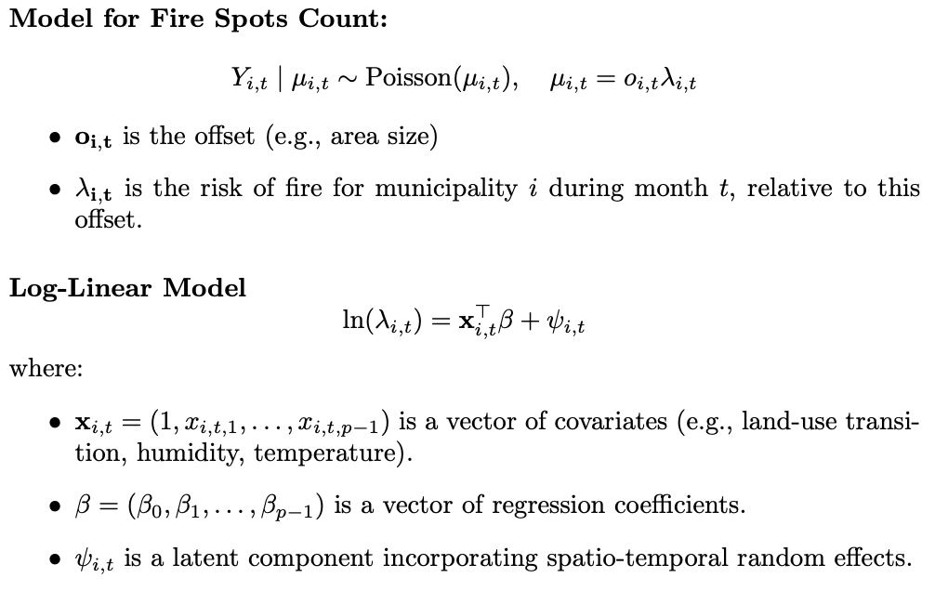
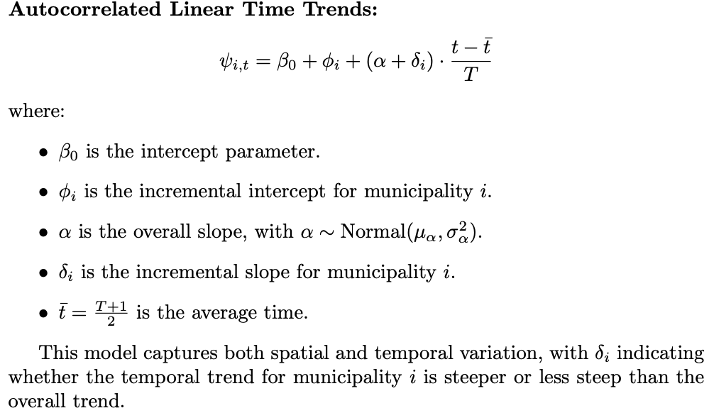
Model
Goal: model the total number of fire spots summarized by municipality and month, using variables: meteorological factors (precipitation, temperature, humidity, radiation) and land-use transitions

Slide 13
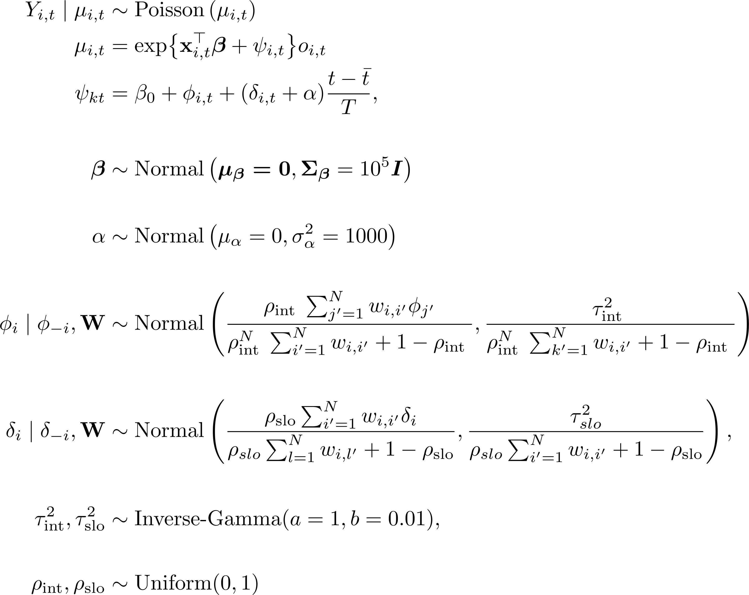
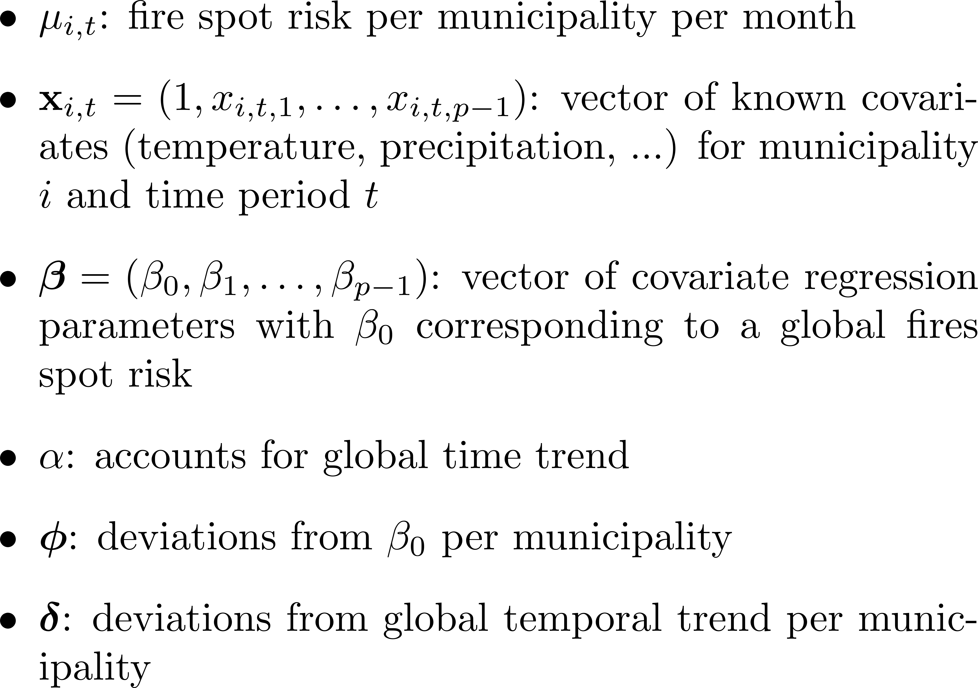
Bayesian Model
Goal: model the total number of fire spots summarized by municipality and month, using variables: meteorological factors (precipitation, temperature, humidity, radiation) and land-use transitions
Model & Likelihood
→ spatio-temporal generalized linear mixed model
1st Tier Priors
2nd Tier Priors

Slide 14
Bayesian approach
Goal: Model the parameters $β (6 Parameters), α$using a Bayesian approach.
Methode: MCMC with 30,000 iterations (with burn-in phase discarded) is used for estimation
# Model
@jax.jit
def model_biome_small(data, t, beta, alpha):
vec_LUT = data[0]
vec_Prec = data[1]
vec_Temp = data[2]
vec_Humid = data[3]
vec_Speed = data[4]
vec_Area = data[5]
# linear regression part of the model
regr = (beta[0] + beta[1] * vec_LUT + beta[2] * vec_Prec + beta[3] * vec_Temp +beta[4] * vec_Humid + beta[5] * vec_Speed)
# latent component of the model
aux_times = (t - (T_value + 1) / 2) / T_value
psi = alpha * aux_times
# expected number of fire spots per municipality per month
mu = jnp.exp(regr + psi + jnp.log(vec_Area))
return mu
# log of likelihood: FS_i,t|µ_i,t ~ Poisson(µ_i,t)
@jax.jit
def log_likelihood_small(FS, data, t, beta, alpha):
mu = model_biome_small(data, t, beta, alpha)
log_poissons = (FS * jnp.log(mu) - mu - gammaln(FS + 1))
return jnp.sum(log_poissons)
@jax.jit
def log_prior_prob_small(beta, alpha):
log_alpha_prior = norm.logpdf(alpha, loc=0, scale=1000)
log_beta_prior = multivariate_normal.logpdf(beta, mean=jnp.zeros(6), cov=10**5 * jnp.eye(6))
return log_beta_prior + log_alpha_prior
@jax.jit
def log_posterior_small(FS, data, t, beta, alpha):
log_like = log_likelihood_small(FS, data, t, beta, alpha)
log_pri = log_prior_prob_small(beta, alpha)
return log_like + log_pri

Slide 15
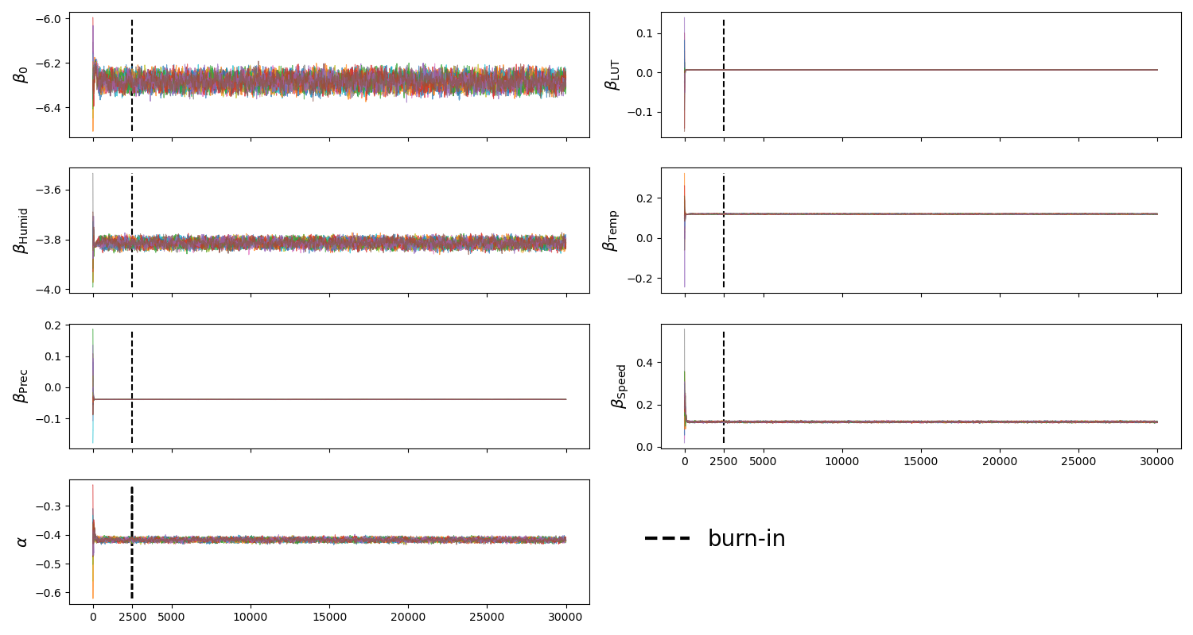
Sampling the posterior (MCMC)

Slide 16
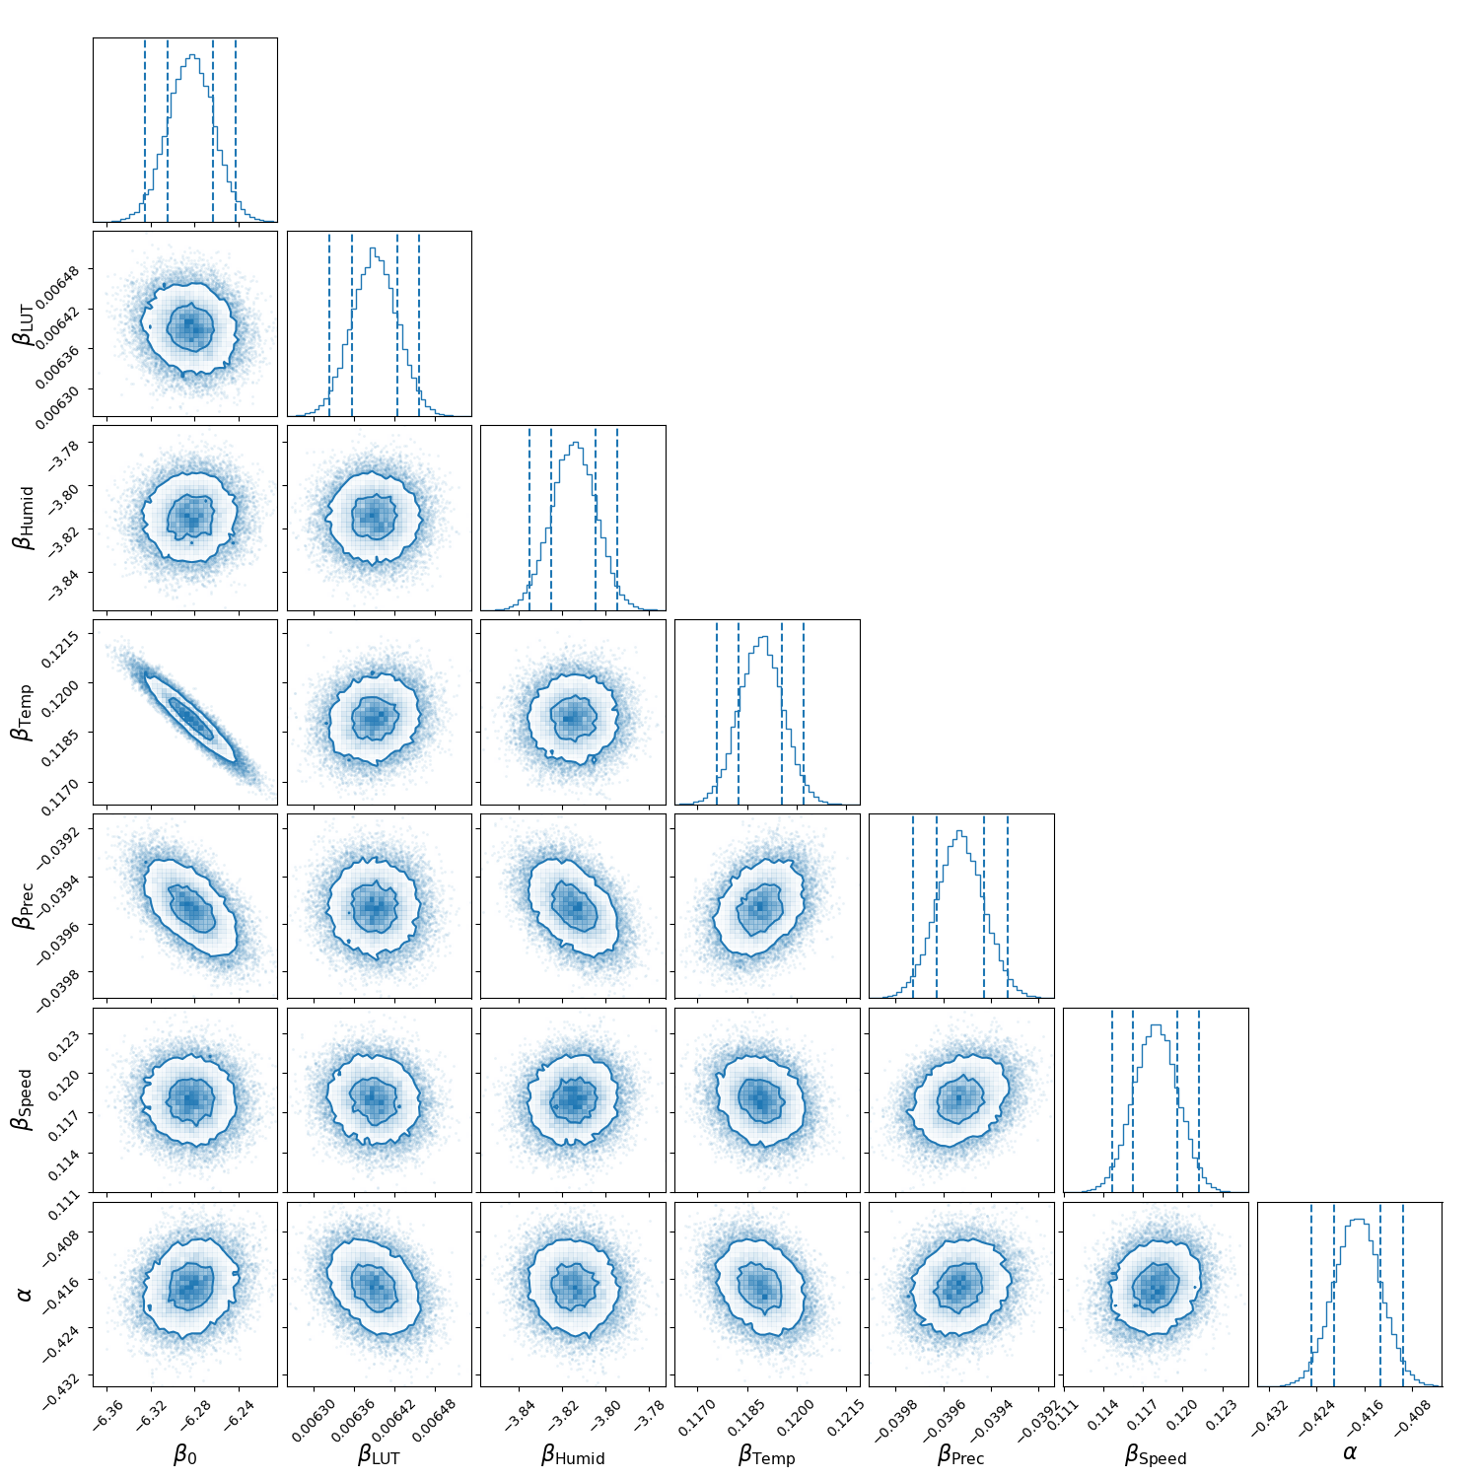
Corner plots

Slide 17
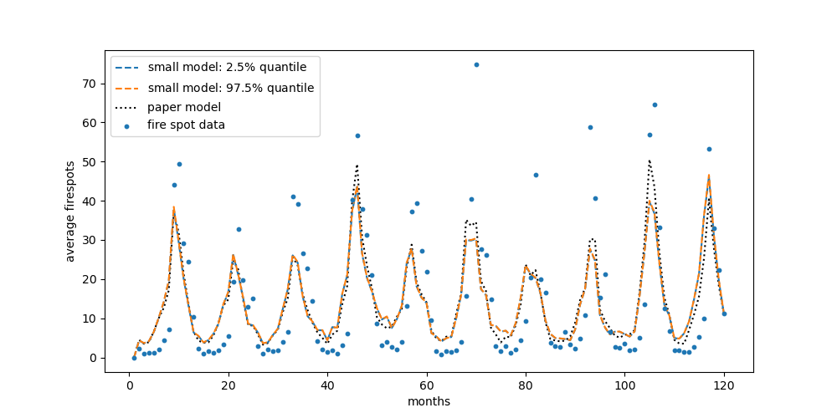
Compare models

Slide 18
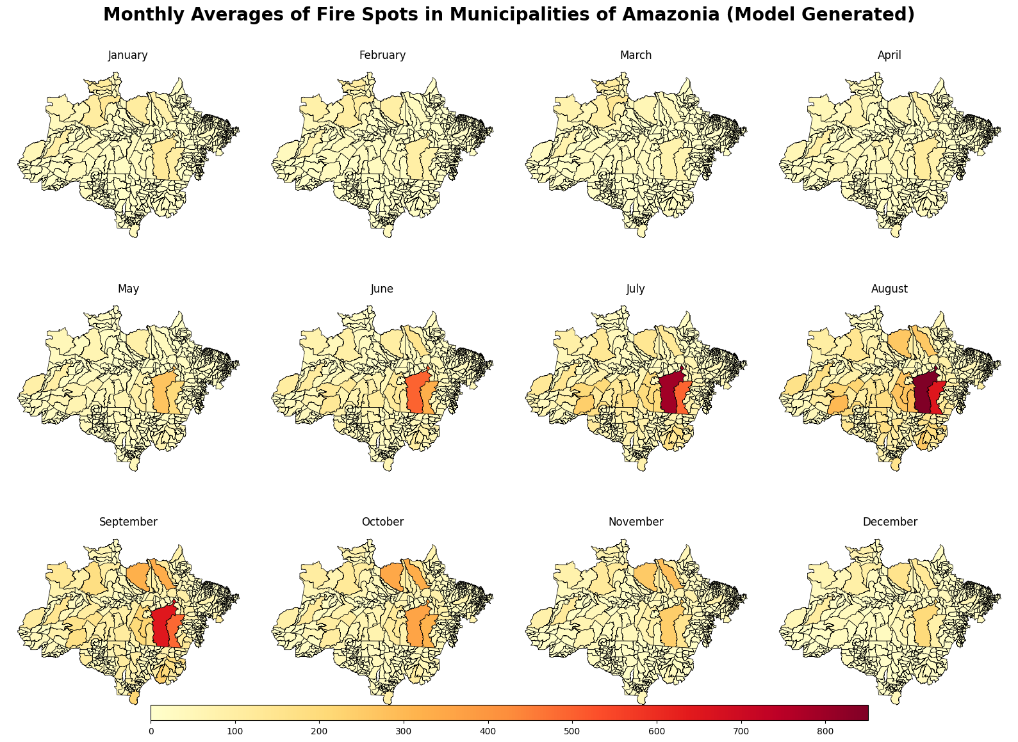
Compare models

Slide 19
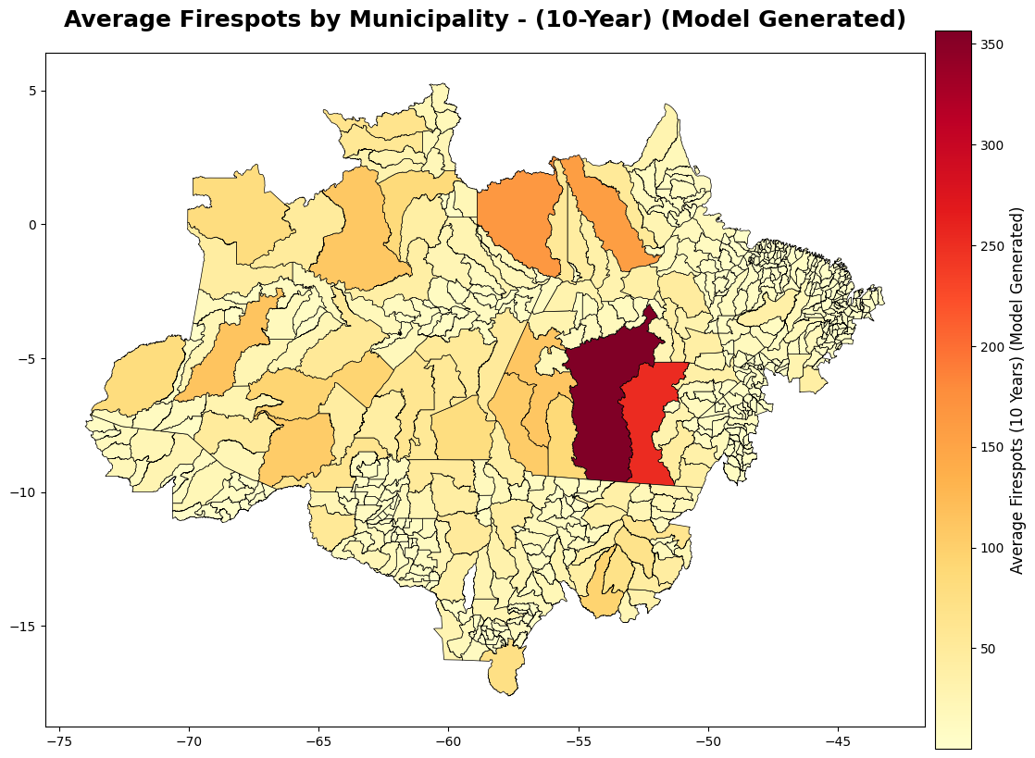
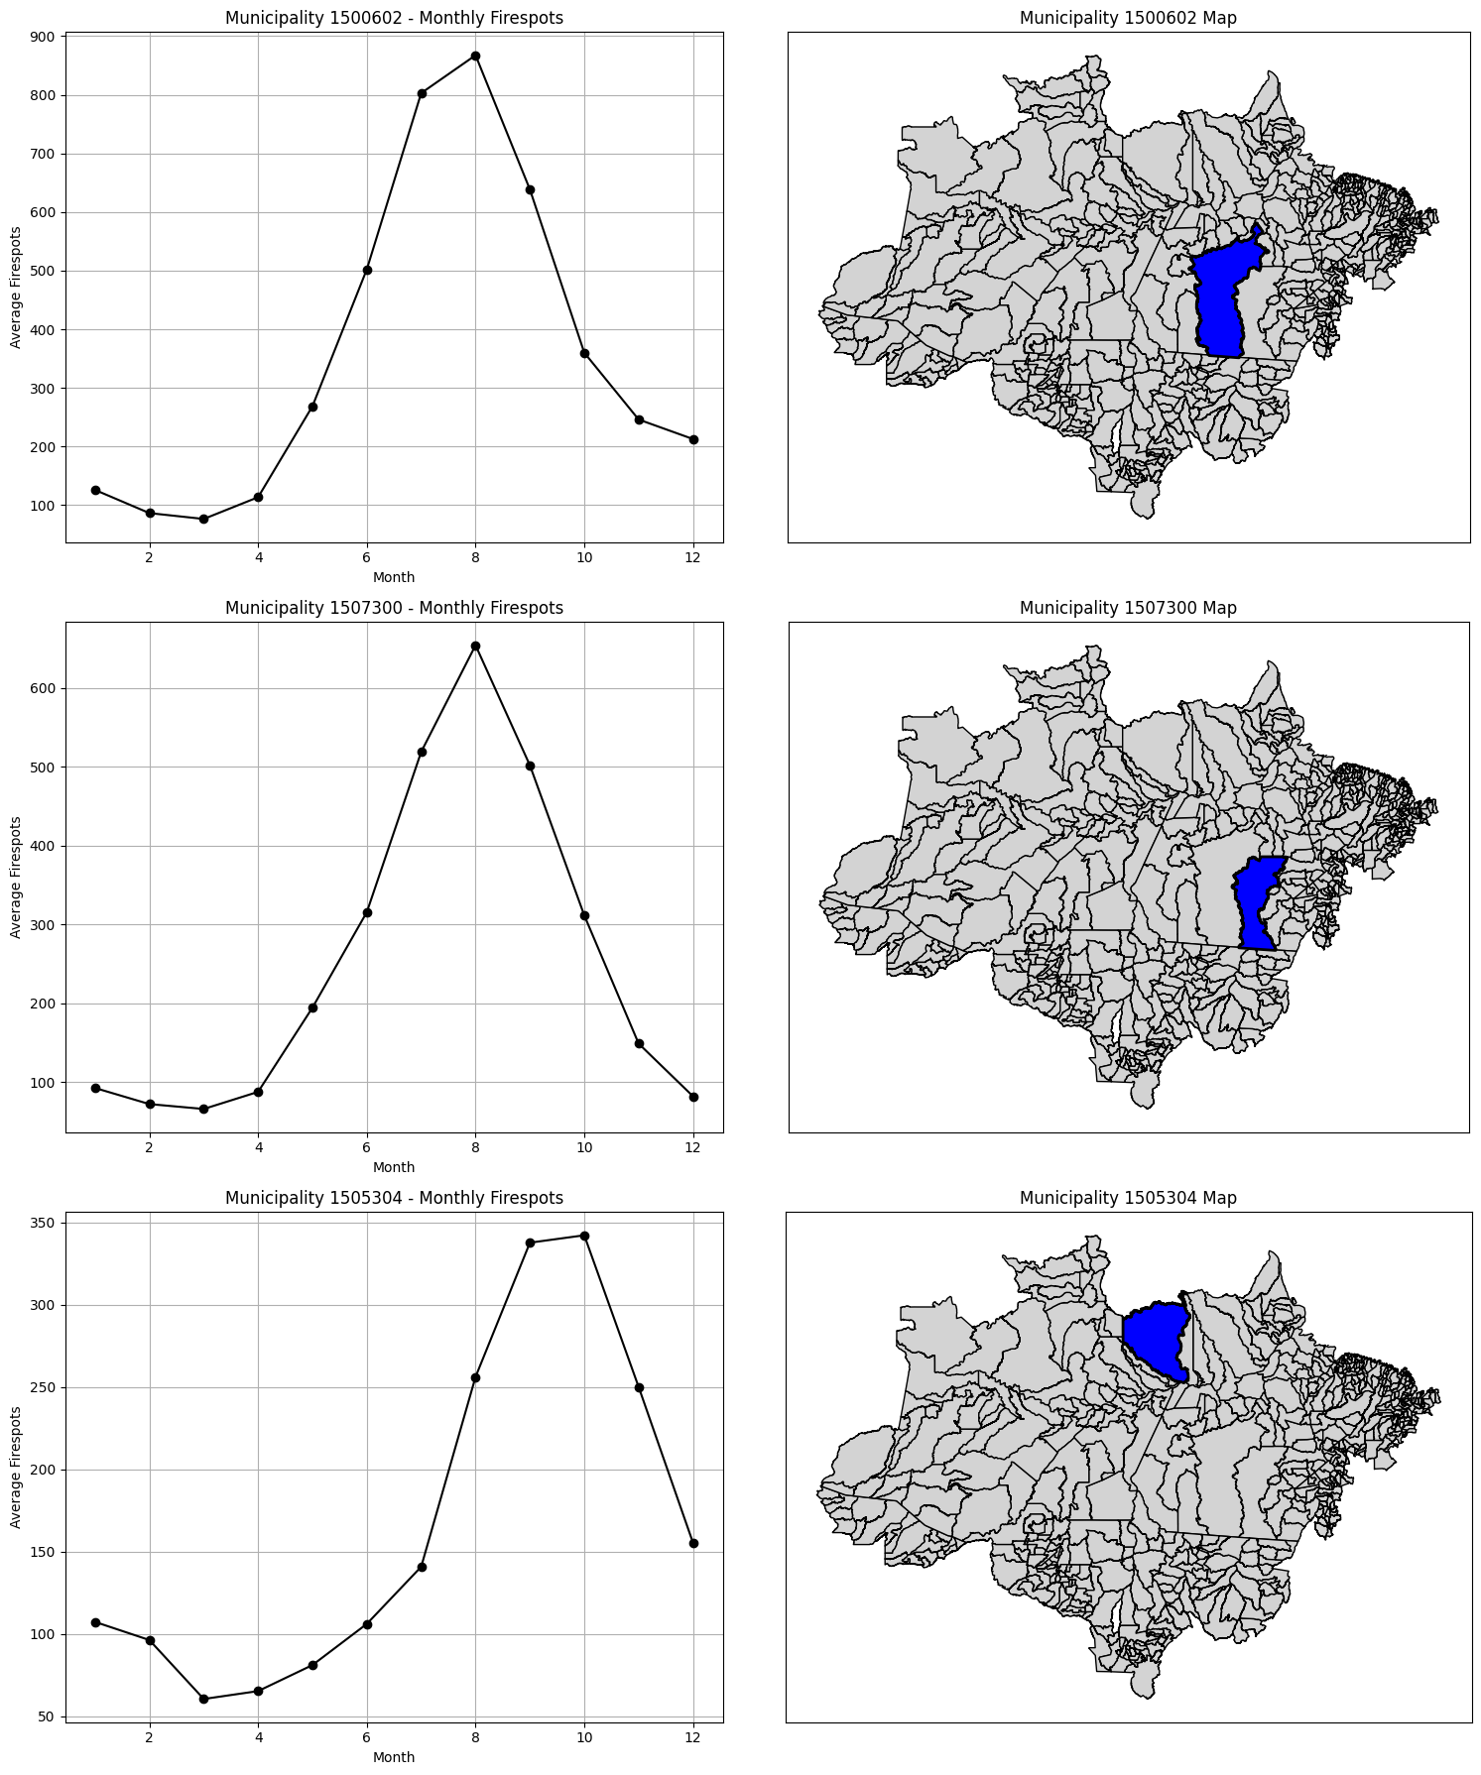
Compare models

Slide 20
Compare models

Slide 21
Compare models
Big model:
DIC: 1 459 754.219
Log likelihood: -728 709.882
Small model:
DIC: 1 304 898 304.0
Log likelihood: -25 457 027.72

Slide 22
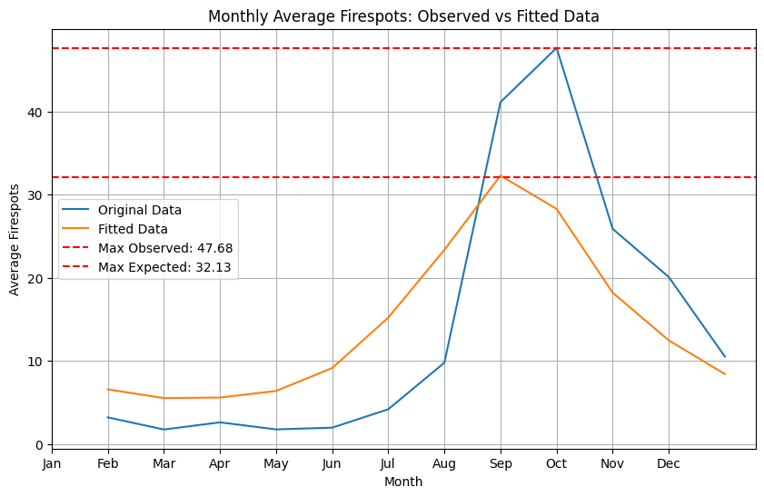

Goodness of fit & Compare models
$χ^{2}$= 55

Slide 23
Jan Fritz: jfritz@student.ethz.ch
Niklas Viebig: nviebig@student.ethz.ch
Luca Titze: ltitze@student.ethz.ch
Victor Windhab: vwindhab@student.ethz.ch

Slide 24
What data do we use and why?
vec_Munic: Unique identifier for the municipality (558 unique ones )
vec_Month: Month of observation (1 to 120)
vec_Area: Total area of the municipality in square kilometers.
vec_FS: Count of firespots detected in the municipality during the month.
vec_LUT: Land Use Transition (hectars)
vec_Prec: Monthly precipitation (mm).
vec_Temp: Average monthly temperature (°C).
vec_Humid: Average monthly relative humidity (%).
vec_Speed: Average monthly wind speed (m/s).
Total Meteorological data : total precipitation, atmospheric pressure (hourly, maximum, and minimum), global radiation, air temperature, dew point temperature (hourly, maximum, and minimum), hourly temperature (minimum and maximum), humidity (hourly, minimum and maximum), wind (direction, maximum gust, and hourly speed)

Slide 25
Where does the data come from?
Fire Spots:
• Source: Brazilian National Institute for Space Research (INPE).
• Data: Satellite images from the AQUA M-T satellite, covering fire spots across Brazil from 2011 to 2022.
• Details: Includes fire spot locations, dates, satellite used, state, municipality, biome, fire risk, and related data. Around 2.2 million fire spots detected over 12 years.
Meteorological Data:
• Source: Brazilian National Institute of Meteorology (INMET).
• Data: Hourly data from meteorological stations across Brazil, from 2012 to 2021.
• Details: Includes precipitation, air temperature, humidity, and wind speed (measured in mm, °C, %, and m/s). The number of meteorological stations grew from 468 in 2012 to 588 in 2021.
Land Use Data:
• Source: Brazilian Annual Land Use and Land Cover Mapping Project (MapBiomas).
• Data: Data on land use and land-use transitions from 2011 to 2021, reflecting human activities.
• Details: Categorizes land use into six main categories, with data organized by municipality and year (in hectares). Transition values show changes in land use over the years, considering area losses or gains.
Difference in Data collection periodes comes due to availability

Slide 26
How was the data treated and cleaned?
Challenges: Missing values, data aggregation, extrapolation, interpolation, and transformation.
Fire Spots:
Problem: Data Summarization and Missing Values, coarseness of MODIS sensor resolution (on TERRA, AQUA)
Solution: Summation: Data was summed by day, associating fire spots with municipalities, states, and biomes.
Days without fire spots were assigned a value of zero.
Climate Data:
• Problem: Missing stations and incomplete records.
• Solution : Monthly Aggregation: Monthly averages for precipitation, temperature, humidity, and wind speed.
Extrapolation: Missing values were estimated using weighted (by distance) averages from the three nearest meteorological stations.
Imputation: Remaining missing values were imputed using the exponential weighted moving average method ( imputeTS in R ­software).
Land Use Data:
• Problem: Data is available annually, but monthly data is needed.
• Solution: Monthly values were interpolated from annual data, assuming uniform distribution across months.

Slide 27
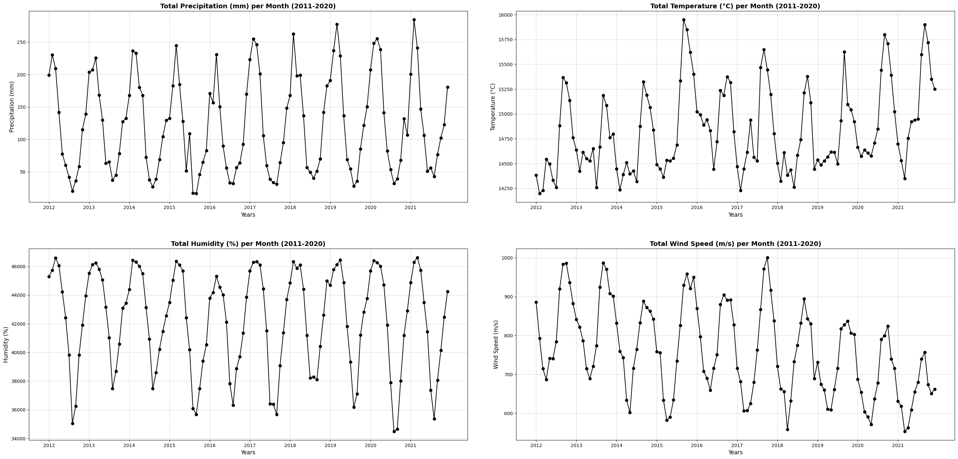
What data do we use?

Slide 28
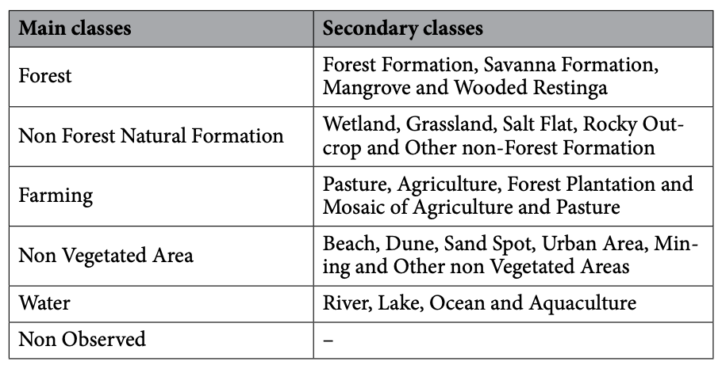
LUT Categories
Luca/Niklas

Slide 29
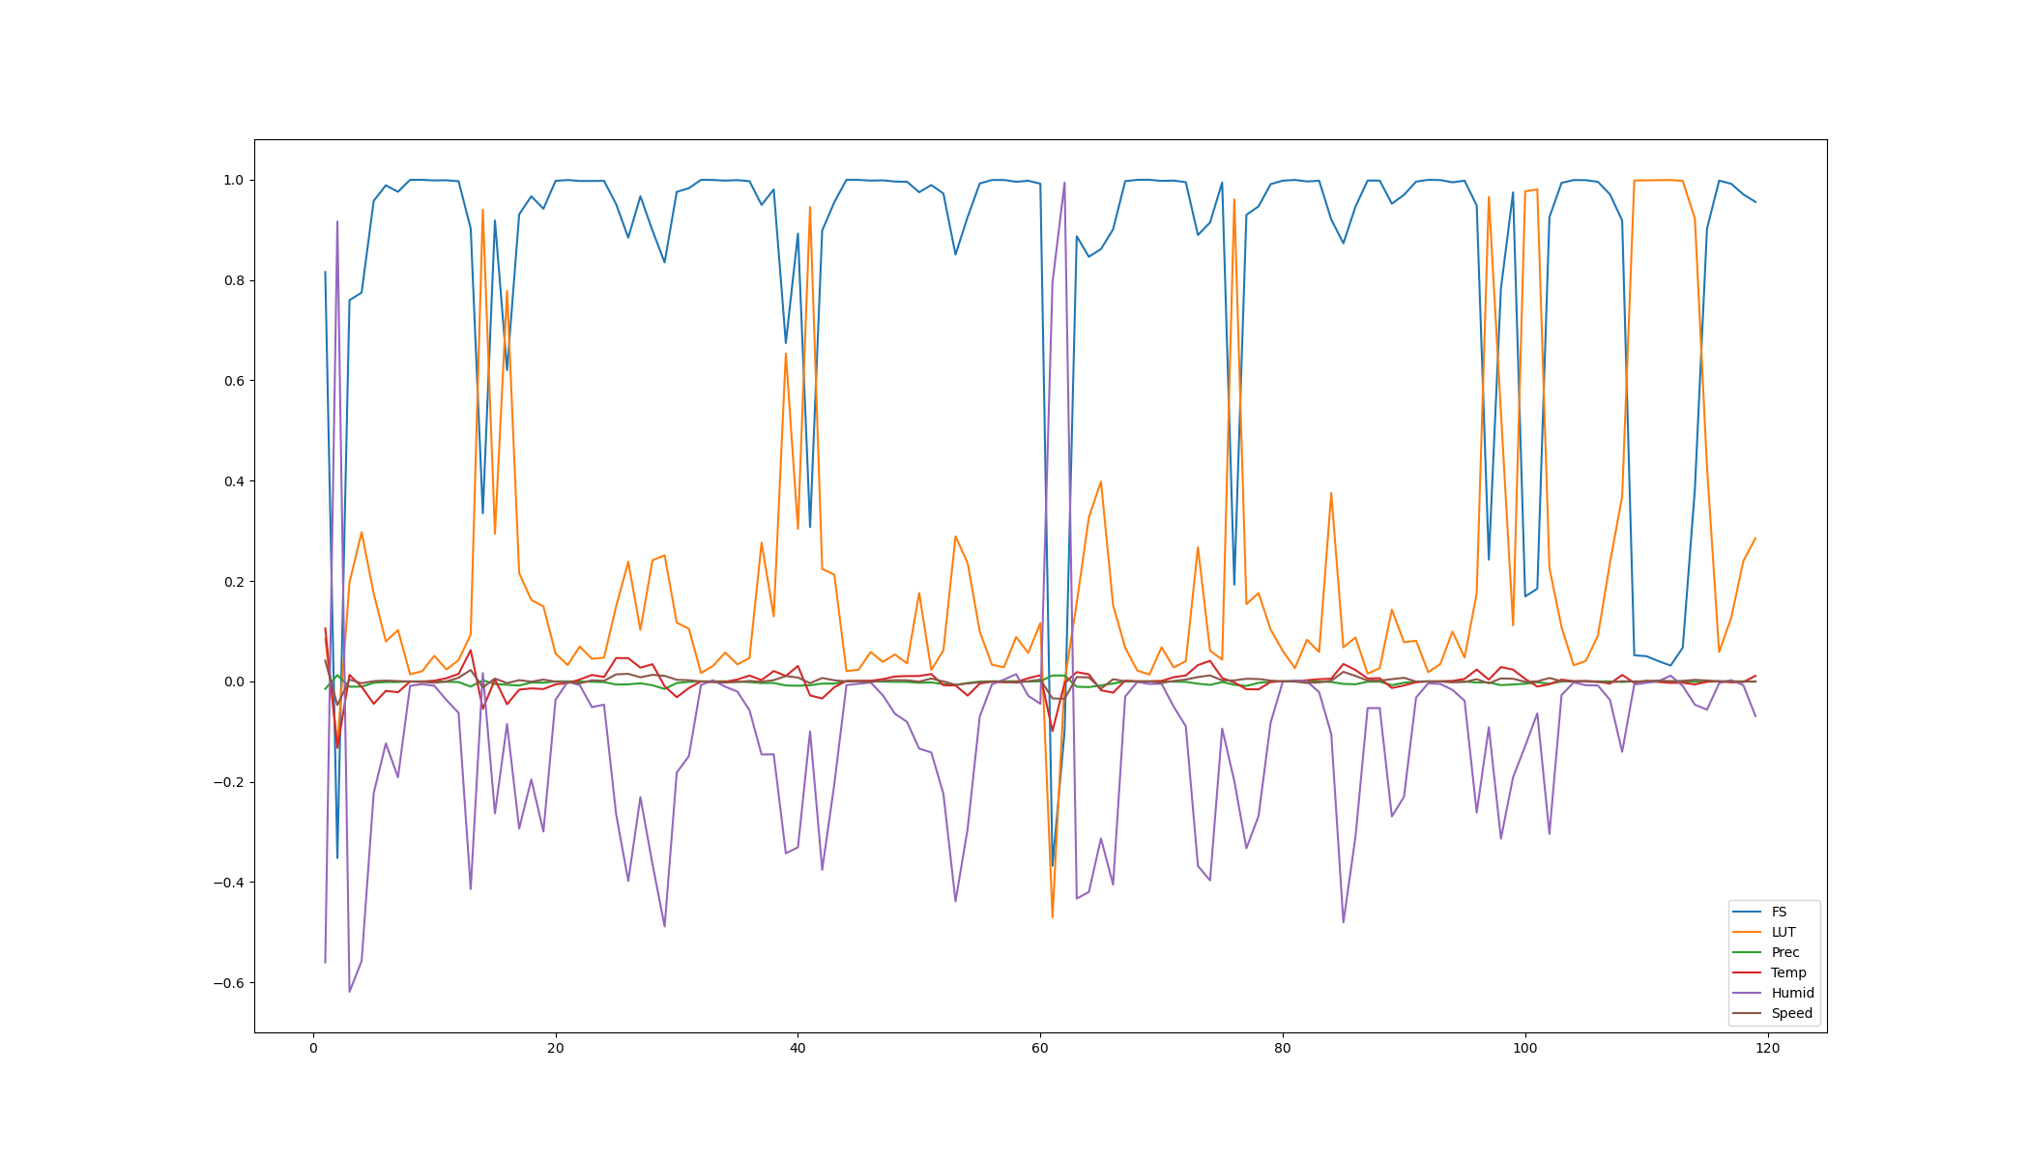

Slide 30
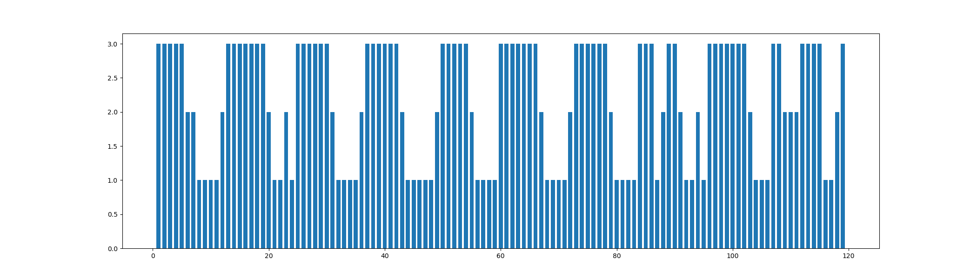
Principal Component Analysis I

Slide 31
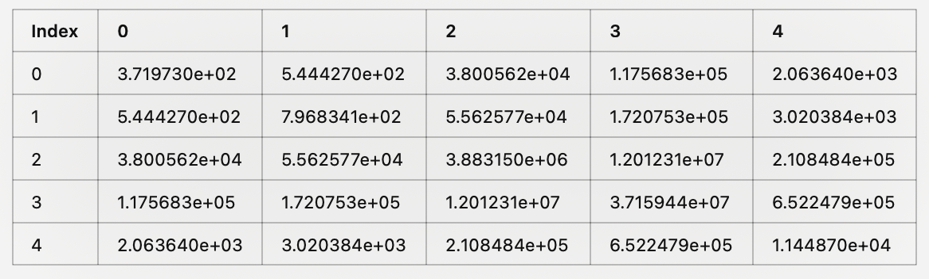
Fisher Information Matrix

Slide 32

Goodness of fit & Compare models
$χ^{2}$= 55
Poor Fit: A high χ² value typically means that the model does not fit the data well, as the residuals (differences between the model and observed data) are large compared to the expected uncertainties.
Model Mis-specification: It could suggest that the model you are using does not adequately represent the underlying process in the data. This might include missing variables, incorrect assumptions, or an inappropriate model form.
Underestimated Data Uncertainties: A high χ² can indicate that the data uncertainties (errors) are too small, causing the model to appear worse than it actually is.
Insufficient Model Complexity: If the model is too simple, it may not capture enough of the data’s complexity, leading to a poor fit and a high χ² value.
Overfitting (with too many parameters): If the model has too many free parameters relative to the data, it might be overfitting, which can lead to a high χ², as the model starts to “chase” the noise in the data rather than the signal.
Large Deviations from Expected Values: A high χ² value can reflect large deviations between the predicted and observed values, which could indicate significant systematic errors or issues with the assumptions made during data collection or modeling.
High Degrees of Freedom: A high χ² could also be expected in models with many data points, especially if the degrees of freedom (dof) is large, but the degree of mismatch is still significant, making the χ² large despite a large dof.
Poor Predictive Power: If your model cannot make accurate predictions (based on the chi-squared value), it suggests that the model is not well-suited to predict new data or that important factors are missing.

Slide 33
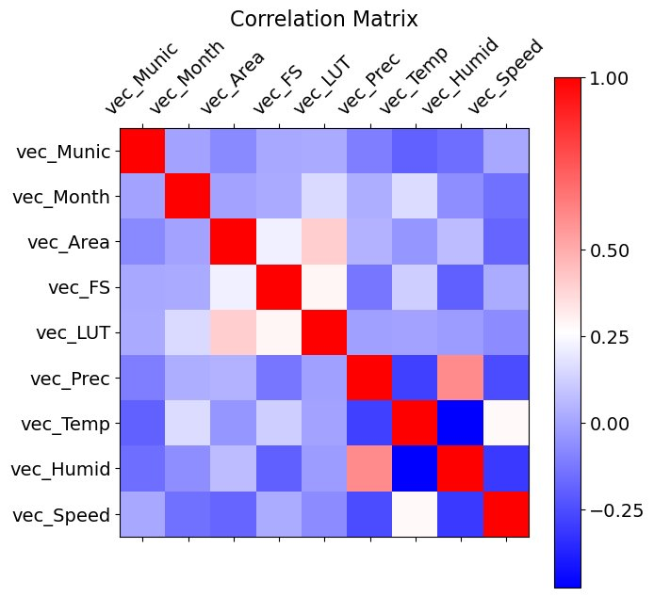

Slide 34
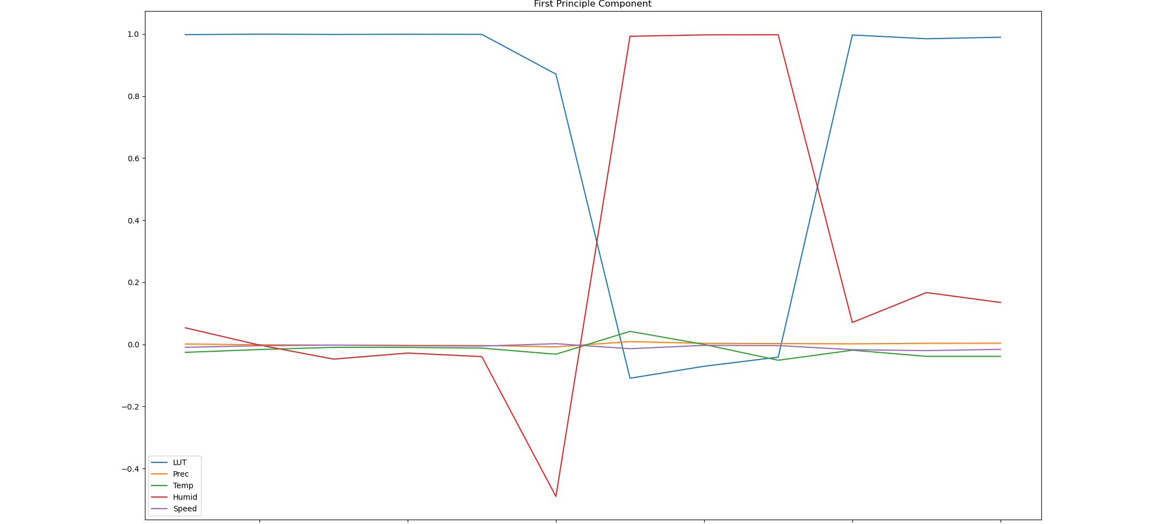
Principal Component Analysis

